Slide 1

DATA ANALYSIS ON YoUnicam APP dataset
DATA ANALYTICS
Dr. Massimo Callisto De Donato
R.S.KEERTHI
AHMED DODIA

Slide 2
Project analysis slide 8
Project Description
The objective of this project is to perform data analysis on the data collected with the mobile App YoUnicam.
Statistics should be implemented in MongoDB Charts (https://docs.mongodb.com/charts/saas/#mongodb-charts).

Slide 3




Project analysis slide 8
Technologies used
Python
Pandas
Jupyter notebook
MongoDB
Mongo shell
Mongodb Compass
Git and github

Slide 4
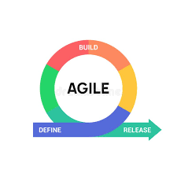

Project analysis slide 2
Project Analysis
Cleaning the data
Agile methodology
PROJECT
Analysis the data
MongoDB charts
Scrum framework
Implemention

Slide 5
Project analysis slide 3
Cleaning the dataset
Data cleaning is the process of fixing or removing incorrect, corrupted, incorrectly formatted, duplicate, or incomplete data within a dataset. we have used some methods to make data free from the irrelevant data.
Handling missing data
Removing irrelevant data
Removing the duplicate data
merge data sets
Import data
Merge data sets
Rebuild missing data
Standardize data
Normalise data
Export data
De-duplicate data
Verify and enrich data
Data cleaning

Slide 6
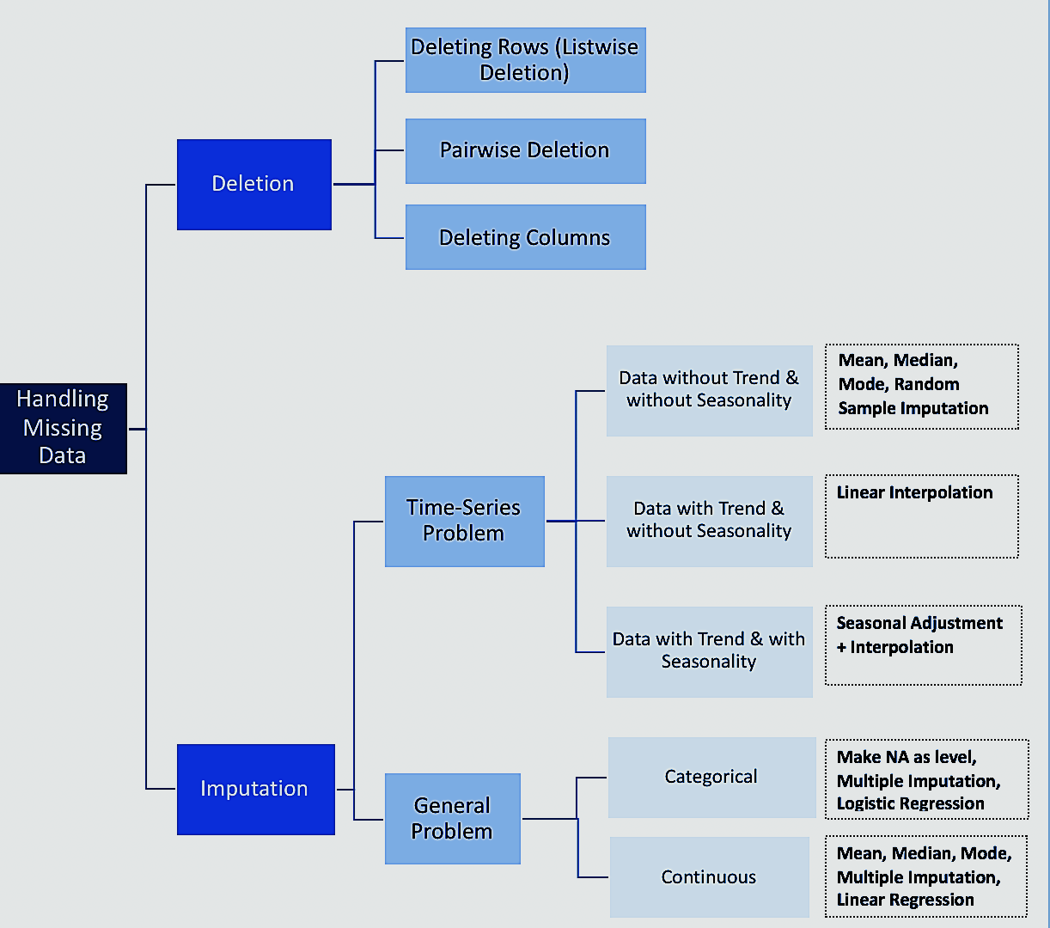
Project analysis slide 3
Handling missing data
Missing data present various problems. First, the absence of data reduces statistical power, which refers to the probability that the test will reject the null hypothesis when it is false. Second, the lost data can cause bias in the estimation of parameters. Third, it can reduce the representativeness of the samples. Depending on the data importance, we can carry out deletion or imputation methods.

Slide 7
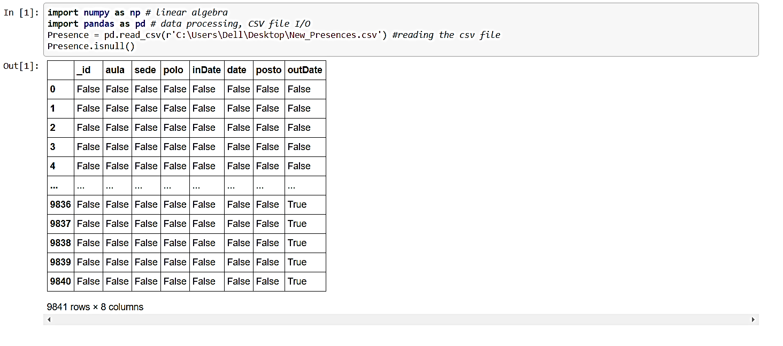
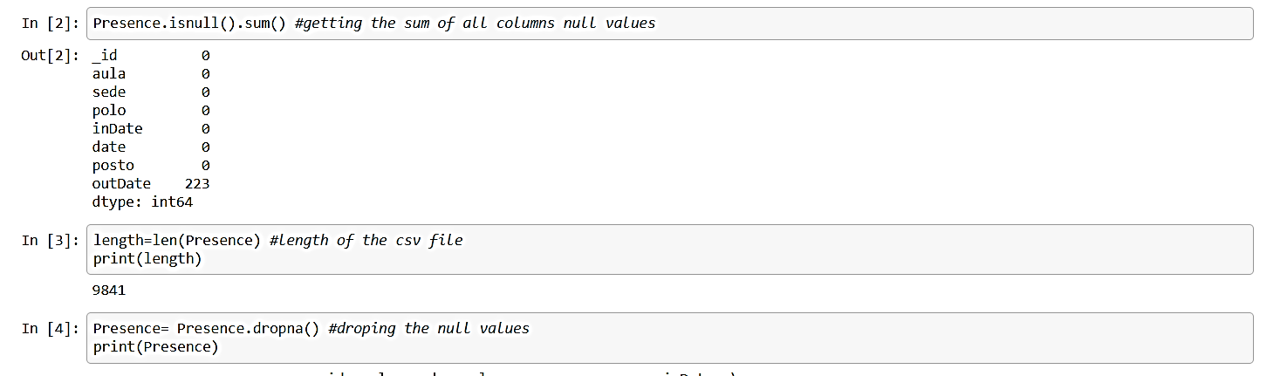
Project analysis slide 3
Handling missing data
Loading the data using the pandas read_csv function.
Presence= pd.read_csv(file location)
And then looking for the null values in the data set using the isnull() function.
Presence.isnull()
Then depending on the importance or the impact of that data on the other fileds of data. The data is either carried out to deletion or imputation.
Presence= presence.dropna()
Or
na.mean(presence, option = "mean")
(options: mean, median, mode)

Slide 8
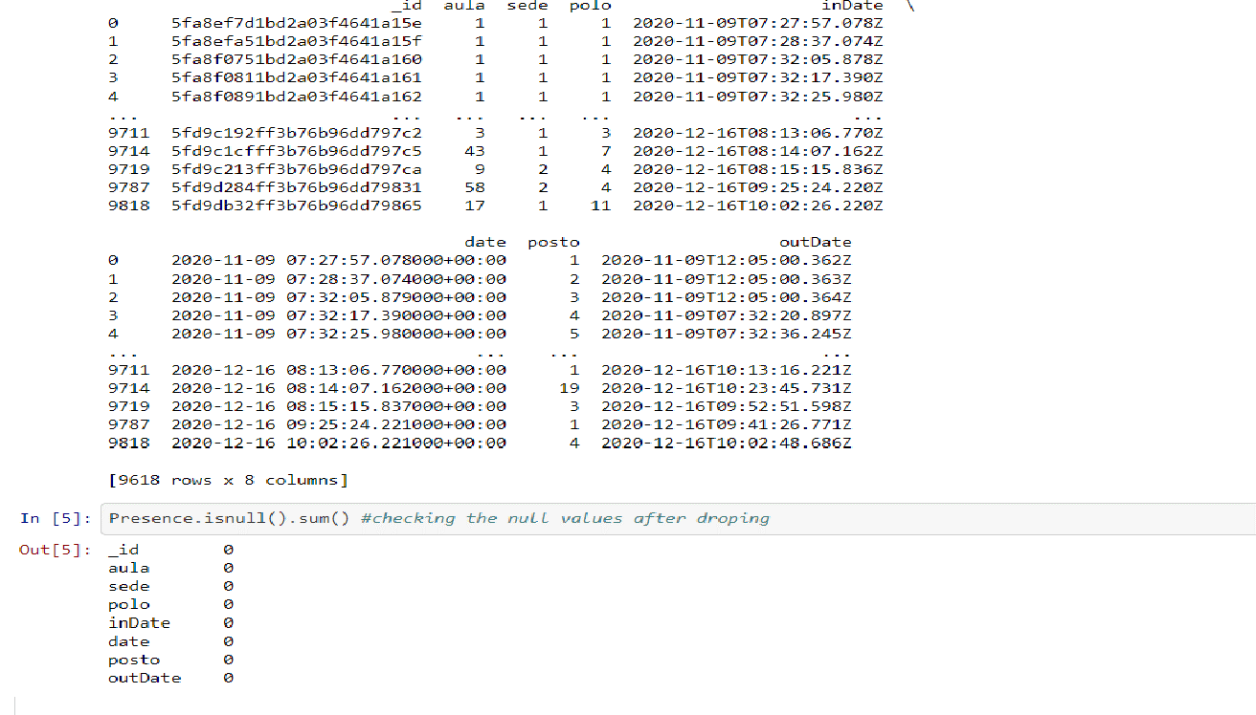
Project analysis slide 3
Handling missing data
Result

Slide 9
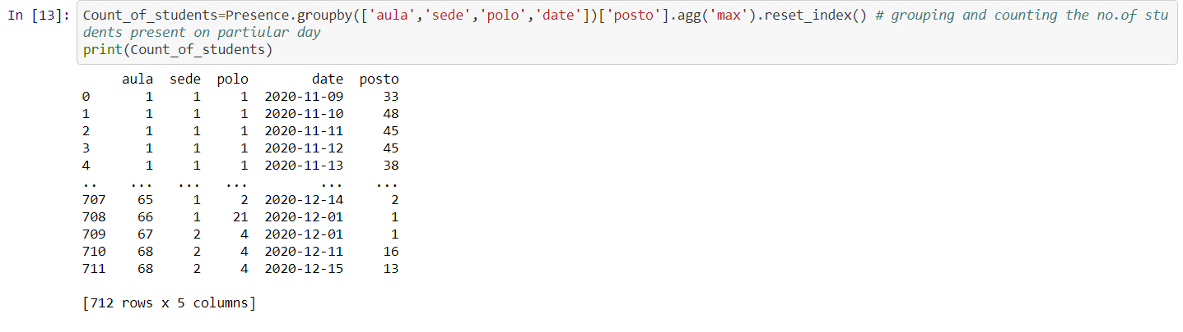
Project analysis slide 3
Removing irrelevant data
Irrelevant observations are those that don’t actually fit the specific problem that your trying to solve. That can be said as extra data that has no impact on the data frames or can be used for analysis.
We have used groupby() function to remove the irrelevant data from data sets.

Slide 10
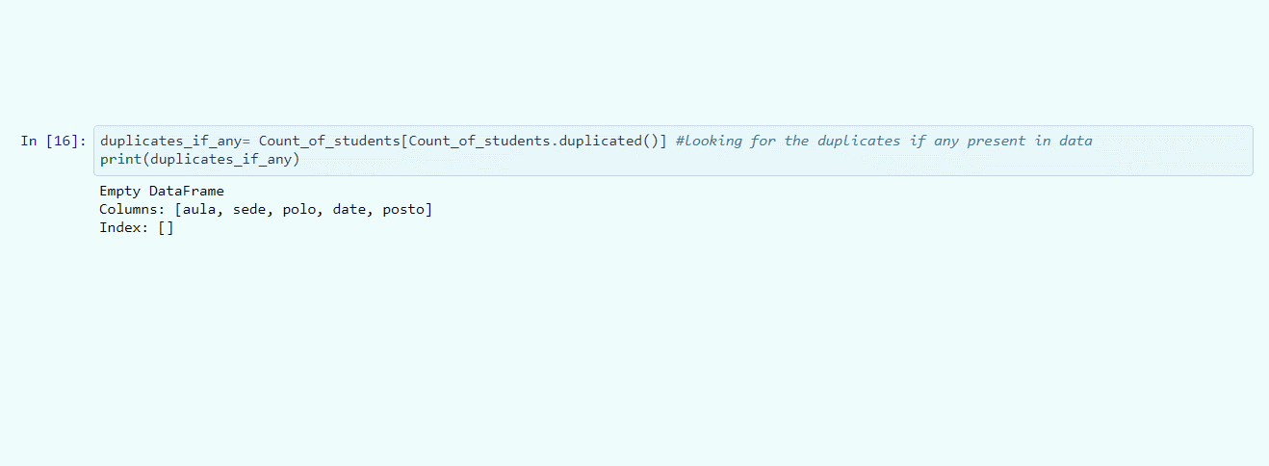
Project analysis slide 3
Removing Duplicate data
Duplicate observations will happen most often during data collection. When you combine data sets from multiple places, scrape data, or receive data from clients or multiple departments, there are opportunities to create duplicate data. De-duplication is one of the largest areas to be considered in this process.
We have used the duplicates_if_any() function to look for duplicates in the datasets.

Slide 11
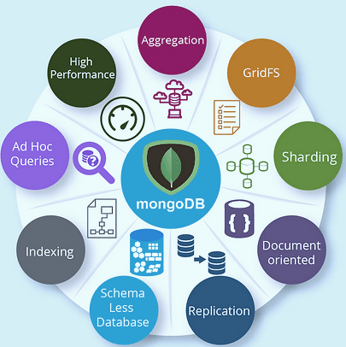
Project analysis slide 3
MongoDB
MongoDB is a document-oriented NoSQL database used for high volume data storage. Instead of using tables and rows as in the traditional relational databases, MongoDB makes use of collections and documents. Documents consist of key-value pairs which are the basic unit of data in MongoDB. Collections contain sets of documents and function which is the equivalent of relational database tables. MongoDB is a database which came into light around the mid-2000s.

Slide 12
Project analysis slide 3
MongoDB Charts
MongoDB Charts is a tool to create visual representations of your MongoDB data. Data visualization is a key component to providing a clear understanding of your data, highlighting correlations between variables and making it easy to discern patterns and trends within your dataset. To work with Mongodb charts there are some prerequisties. They are as follows..,
Mongodb atlas account
Datasource
Network access
Atlas project and cluster

Slide 13
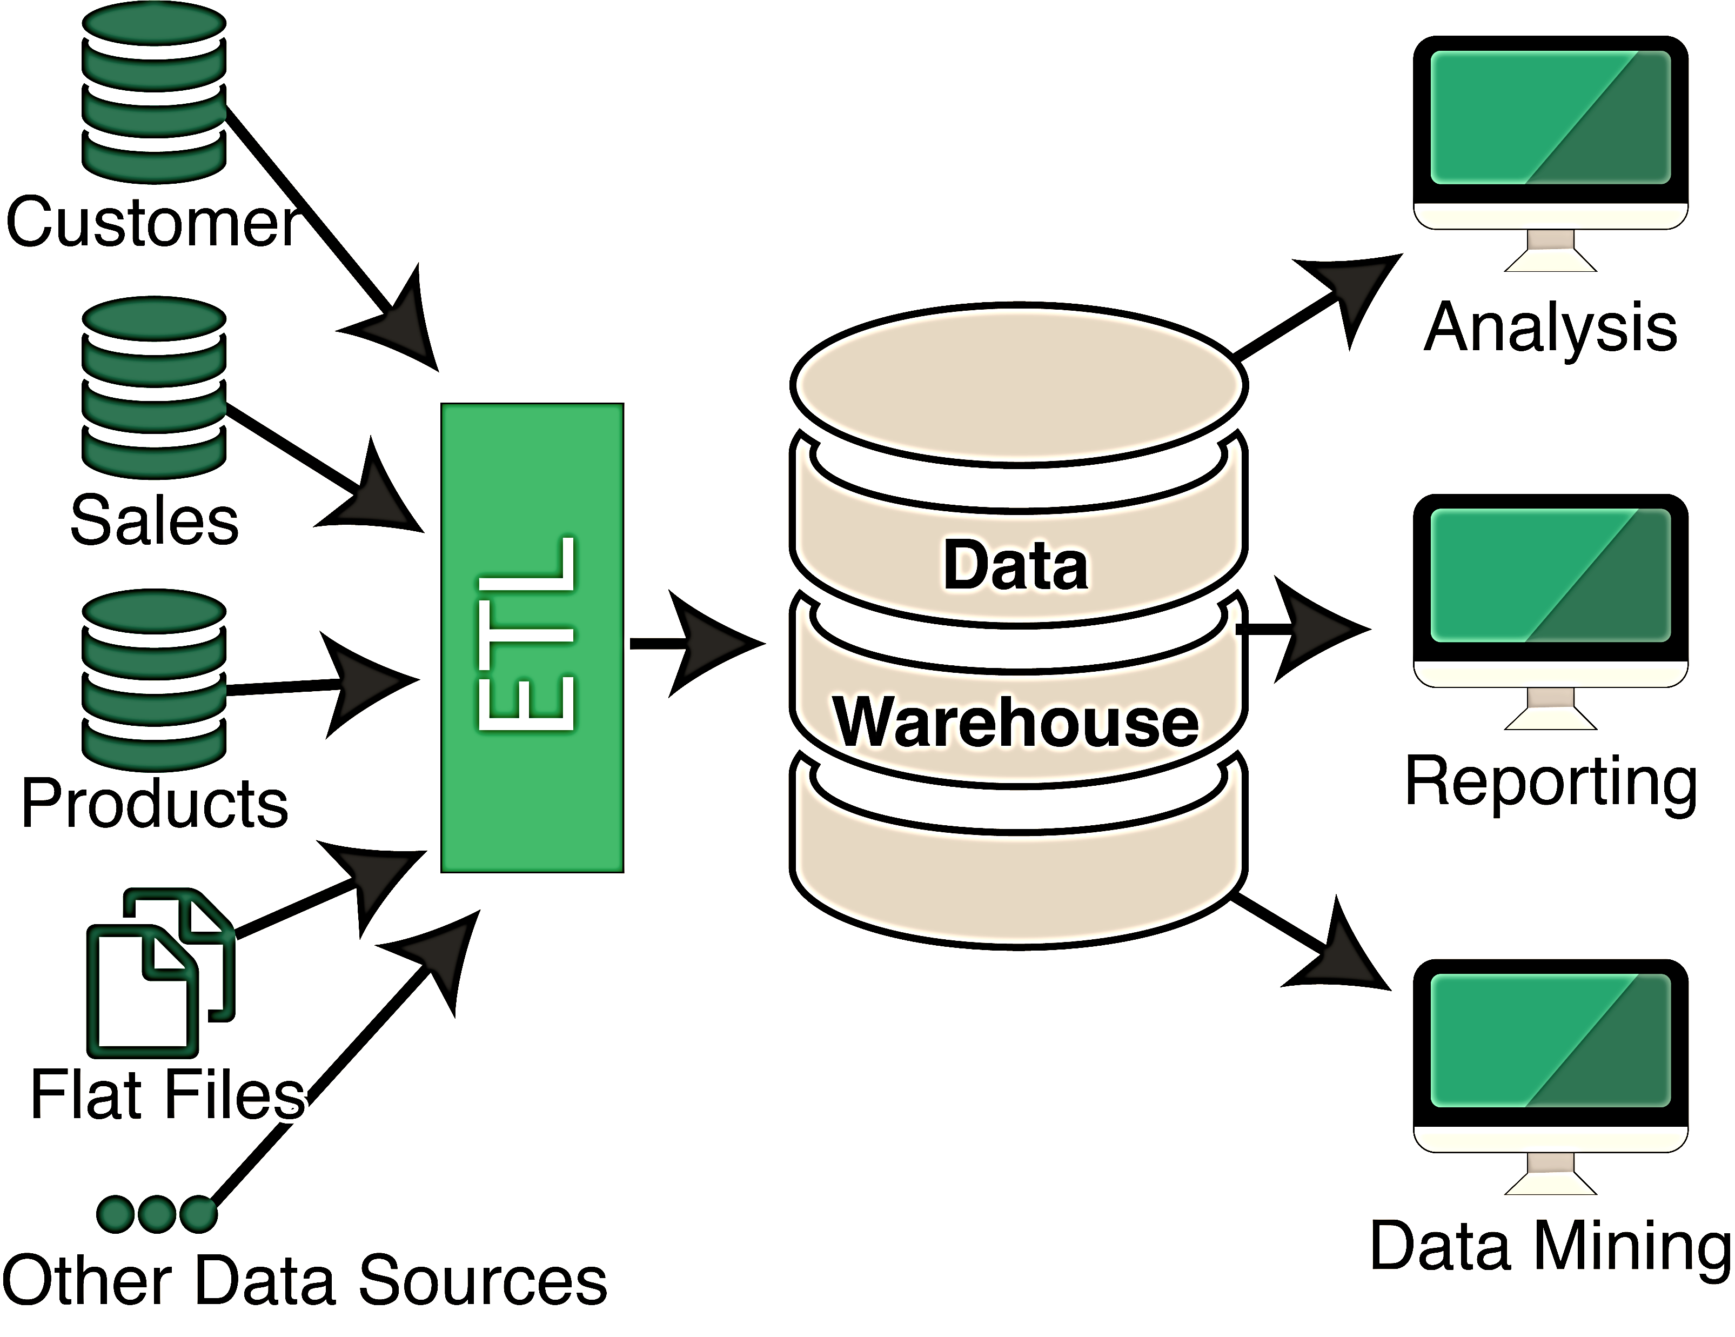
Project analysis slide 3
MongoDB Charts
Mongodb charts reduces the need of ETL process. With MongoDB Charts you can connect to your MongoDB server, assign user authorization policies to your reports, and easily generate visualization dashboards. With over a dozen different chart variations to choose from, stunning visualizations are just a few clicks away.
MongoDB Charts allows for data to be visualized without performing ETL operations, saving valuable time and resources. You don’t need to write any code or rely on third-party tools. Further, you still get to leverage the richness of the Document Model.

Slide 14
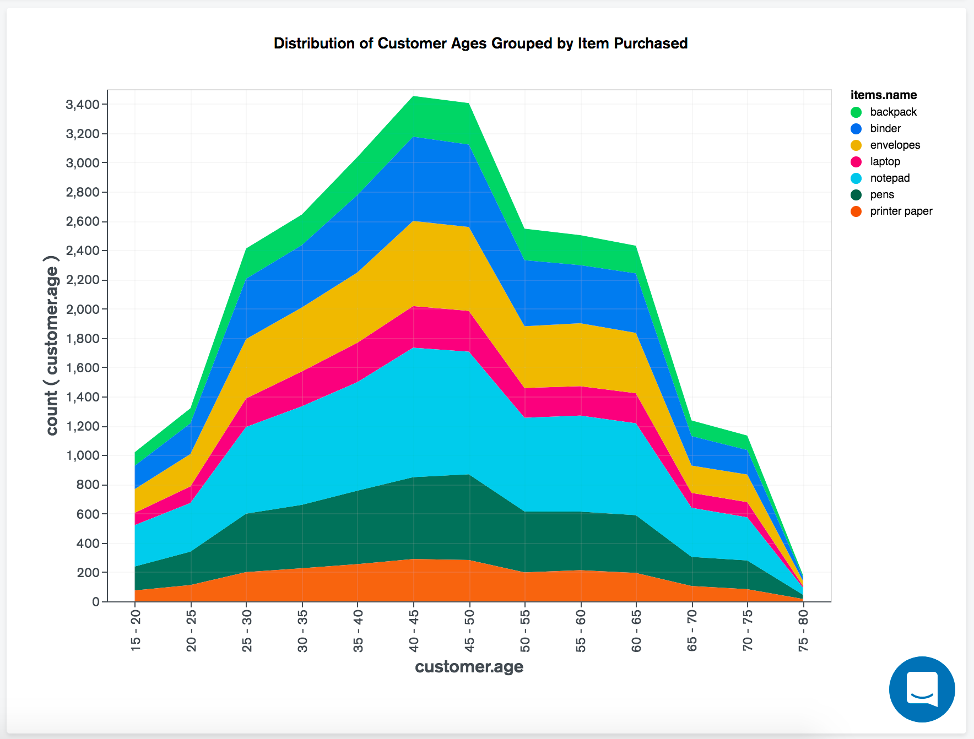
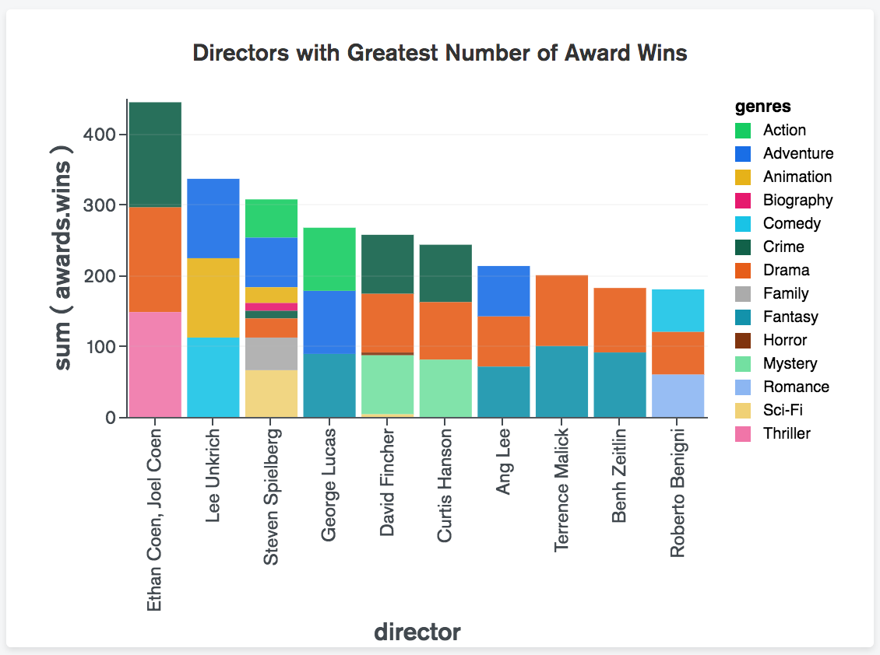
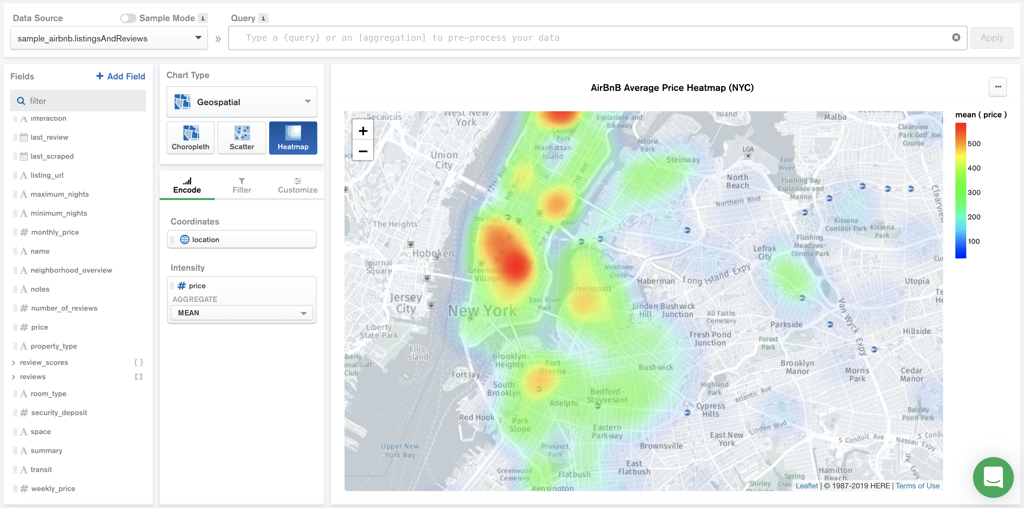
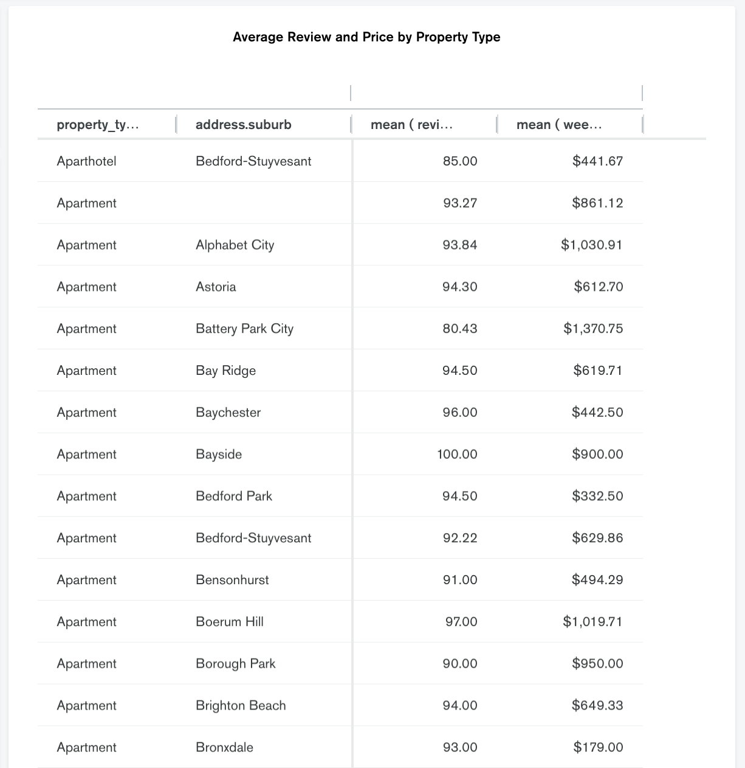
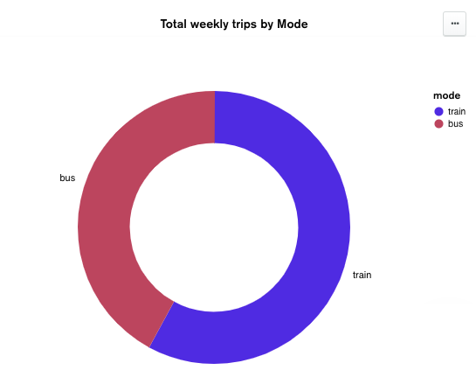
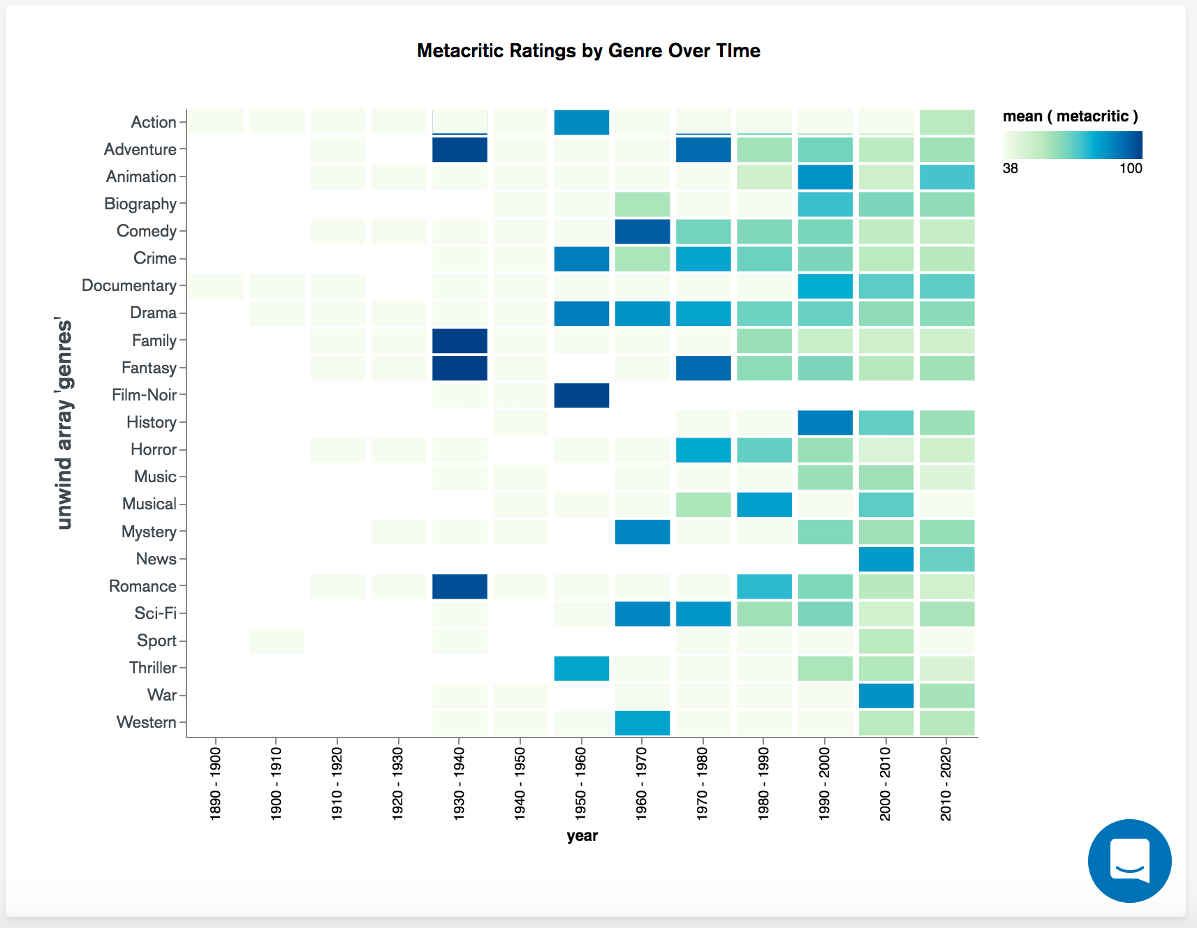
Project analysis slide 3
MongoDB Charts types
MongoDB Charts provides a wide variety of chart types to visualize your data. Based on the type and sequence of data, we can represent them in the following types of charts..,
Column and Bar Charts.
Line and Area Charts.
Grid Charts.
Heatmaps.
Scatter Charts.
Circular Charts.
Donut Charts.
Gauge Charts.
Text Charts
Data Tables
Number Charts
Word Clouds
Top Item Charts
6. Geospatial Charts

Slide 15
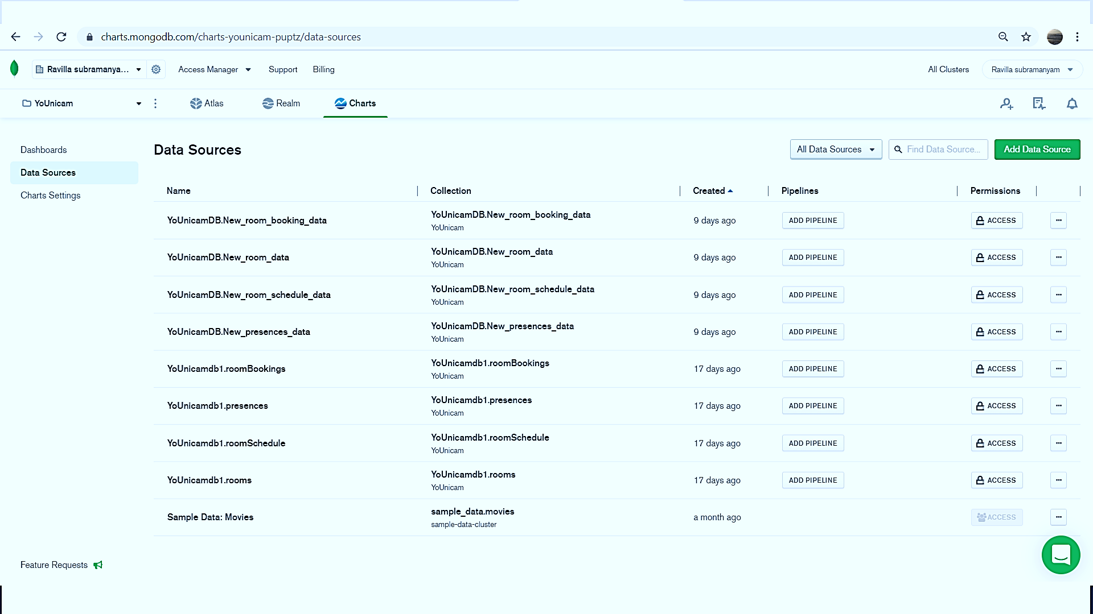
Project analysis slide 3
Concepts
Data can be imported to or exported from mongoDB. In mongoDB data is stored as documents. which are gathered together in collections. A database stores one or more collections of documents. Data sources in MongoDB Charts reference a collection or view in your MongoDB deployment. The fields in that collection or view can be used to construct a chart. When building a chart, you will need to specify the data source that the chart uses.
Data Source:

Slide 16
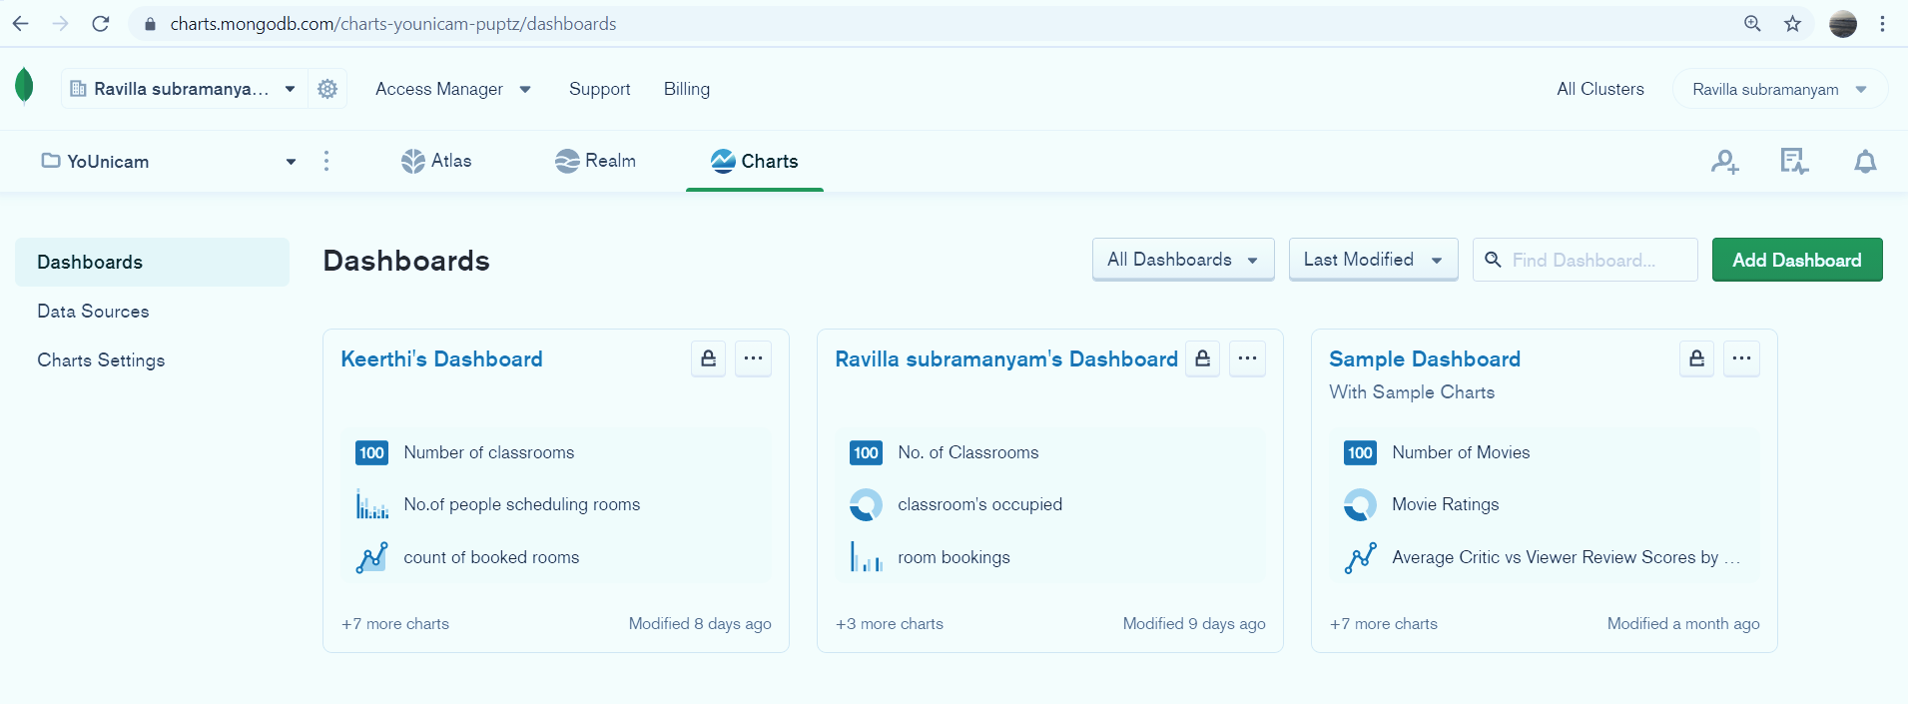
Project analysis slide 3
Concepts
Dashboards are a collection of charts assembled to create a single unified display of your data. Each chart shows data from a single MongoDB collection or view, so dashboards are essential to attain insight into multiple focal points of your data in a single display. Dashboards can be shared with other users.
Dashboard:

Slide 17
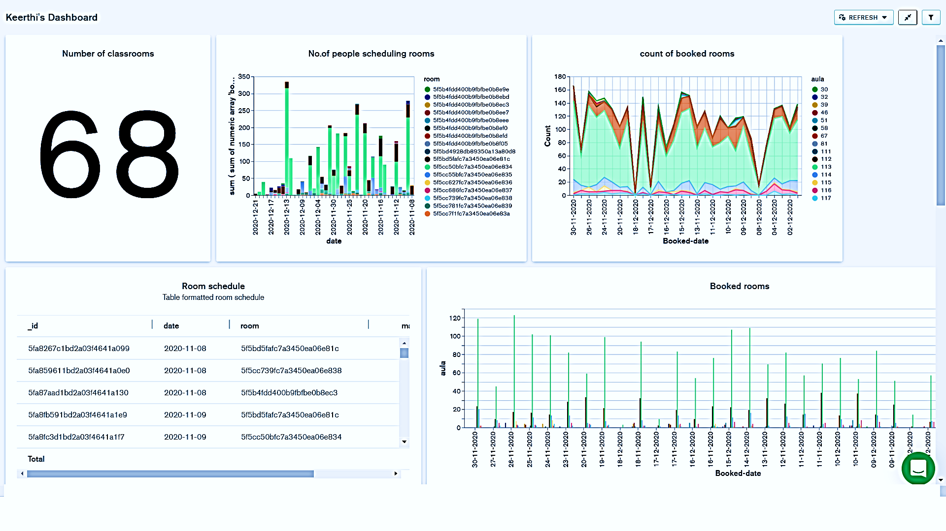
Project analysis slide 8
Achieved results

Slide 18







Project analysis slide 8
Alternate options
Google Chart Tools.
Totango.
Chartio.
GoodData.
SAP Lumira.
Google Data Studio.
Klipfolio.
Grow.com.

Slide 19
Project analysis slide 10
DEMO
Demo

Slide 20
Thank You

